Slide 1
HCI Evaluation Part Two
Dr Jon Bird
jon.bird@bristol.ac.uk
Thanks to Stuart Gray, Pete Bennett, Simon Lock, Thomas Bale, Harry Field who developed some of these slides
Images are royalty free from www.pexels.com

Slide 2

Today’s Lecture
Questionnaires
NASA Task Load Index (NASA TLX)
System Usability Scale (SUS)
Statistical tests to determine if the perceived workload or system usabiity score has changed significantly
Notes:
调查表
NASA任务负荷指数（NASA TLX）
系统可用性量表（SUS）
统计测试，以确定感知工作量或系统可用性得分是否发生了显著变化

Slide 3

Questionnaires - defined
Questionnaires involve asking people to answer questions either on paper or digitally e.g. on a webpage or app
They can be used at scale with low resource requirements
They generate a collection of demographic data and user opinions
They can be used to evaluate designs and for understanding user requirements
Notes:
问卷包括要求人们在纸上或数字上回答问题，例如在网页或应用程序上
它们可以在低资源需求的情况下大规模使用
它们生成人口统计数据和用户意见的集合
它们可用于评估设计和了解用户需求

Slide 4
Questionnaires - tips
Ensure that you are asking a feasible number of questions (question fatigue is a thing)
Watch out for leading questions e.g. “Why did you have difficulty with the navigation?”
It is difficult to produce your own questionnaires
It is best to use existing questionnaires that have been validated i.e. they measure what they claim to be measuring
I’ll now introduce you to two widely used questionnaires
Notes:
确保你提出了可行数量的问题（问题疲劳是一件事）
注意引导性问题，例如“为什么导航有困难？”
很难制作自己的问卷
最好使用经过验证的现有问卷，即他们测量自己声称要测量的内容
现在我将向您介绍两个广泛使用的问卷

Slide 5
NASA TLX
The NASA Task Load Index (TLX) is a questionnaire that estimates a user’s perceived workload when using a system.
Workload is a complex construct but essentially means the amount of effort people have to exert, both mentally and physically, to use a system.
It was developed by Sandra Hart of NASA’s human performance group and Lowell Staveland of San Jose University.
The focus is on measuring the “immediate often unverbalized impressions that occur spontaneously” (Hart and Staveland, 1988). These are difficult or impossible to observe objectively.
Notes:
美国国家航空航天局任务负荷指数（TLX）是一份调查问卷，用于估计用户在使用系统时的感知工作量。
工作量是一个复杂的结构，但本质上意味着人们为了使用一个系统而必须在心理和身体上付出的努力。
它是由美国国家航空航天局人类性能小组的Sandra Hart和圣何塞大学的Lowell Staveland开发的。
重点是测量“自发产生的即时的、往往未经城市化的印象”（Hart和Staveland，1988）。这些都是难以或不可能客观观察到的。

Slide 6
NASA TLX 2
Originally the NASA TLX questionnaire was developed for use in aviation but it’s since been used in many different domains, including air traffic control, robotics, the automative industry, healthcare, website design and other technology fields.
Since it was introduced in 1988, it has had over 8000 citations.
It is viewed as the gold standard for measuring subjective workload.
Notes:
最初，美国国家航空航天局TLX问卷是为航空业而开发的，但后来它被用于许多不同的领域，包括空中交通管制、机器人、自动化行业、医疗保健、网站设计和其他技术领域。
自1988年推出以来，它已被引用8000多次。
它被视为衡量主观工作量的黄金标准。

Slide 7
NASA TLX 3
Originally it was developed as a paper and pencil questionnaire but there are also free apps for iOS and Android
The official website is here: https://humansystems.arc.nasa.gov/groups/TLX/index.php
Notes:
最初它是作为纸笔问卷开发的，但也有适用于iOS和Android的免费应用程序
官方网站如下：https://humansystems.arc.nasa.gov/groups/TLX/index.php

Slide 8
NASA TLX 4
The NASA TLX uses a multi-dimensional rating procedure that derives an overall workload score based on a weighted average of ratings on six subscales: - Mental Demand - Physical Demand - Temporal Demand - Performance - Effort - Frustration
Notes:
美国国家航空航天局TLX使用多维评级程序，根据六个分量表的加权平均评级得出总体工作量得分：心理需求-身体需求-时间需求-表现-努力-挫折

Slide 9
NASA TLX 5
Mental demand – how much mental and perceptual activity was required?
Physical demand – how much physical activity was required?
Temporal demand – how much time pressure did the user feel due to the rate at which tasks occurred?
Frustration – how insecure, discouraged or irritated did the user feel in the task?
Effort – how hard did the user have to work (mentally and physically) to accomplish their level of performance?
Performance – how successfully did the user think they accomplished the task?
Notes:
心理需求——需要多少心理和感知活动？
体力需求——需要多少体力活动？
时间需求——由于任务发生的速度，用户感受到了多大的时间压力？
挫败感——用户在任务中有多不安全、气馁或恼怒？
努力——用户必须付出多大的努力（精神上和身体上）才能达到他们的绩效水平？
性能–用户认为他们完成任务的成功程度如何？

Slide 10
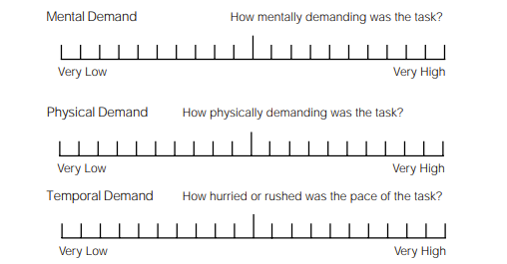
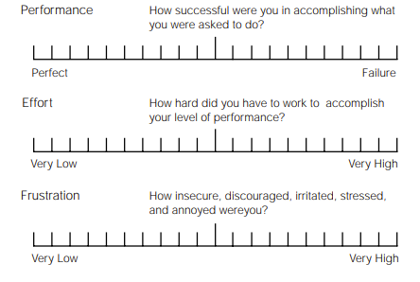
NASA TLX 6

Slide 11
NASA TLX Scoring 1
Users answer the NASA TLX after they have completed a task. This is necessary as asking them to complete it during task is typically not possible. However, it may mean that users forget details of the perceived workload.
The questionnaire is scored in a two step process:
Identifying the relative importance of the 6 dimensions on a user’s perceived workload
Rating each of the 6 dimensions on a scale
Notes:
用户在完成任务后回答NASA TLX。这是必要的，因为要求他们在任务期间完成通常是不可能的。然而，这可能意味着用户忘记了感知工作负载的细节。
问卷分两步进行评分：
识别6个维度对用户感知工作量的相对重要性
在一个量表上对6个维度中的每一个进行评分

Slide 12
NASA TLX Relative weighting of dimensions 1
A user reflects on the task they’ve been asked to perform and is shown each paired combination of the six dimensions to decide which is more related to their personal definition of workload as related to the task.
This means a user considers 15 paired comparisons. For example, they need to decide whether Performance or Frustration “represents the more important contributor to the workload for the specific task you recently performed.”
Each time a dimension is selected as more important it receives a score of 1. The total score is the weight of the dimension and ranges from 0 to 5.
The sum of the weights should be 15.
Notes:
用户反思他们被要求执行的任务，并显示六个维度的每一个配对组合，以决定哪一个与他们个人对与任务相关的工作量的定义更相关。
这意味着用户会考虑15个配对比较。例如，他们需要决定“绩效”还是“挫败感”是对您最近执行的特定任务的工作量的更重要贡献者
每次一个维度被选择为更重要时，它都会得到1分。总分是维度的权重，范围从0到5。
权重之和应为15。

Slide 13
NASA TLX Relative weighting of dimensions 2
The relative weighting of the six dimensions is often not measured or used.
Not measuring the relative weighting makes the NASA TLX simpler to administer.
Several studies have compared raw TLX scores to weighted TLX scores and have found mixed results (some showing better sensitivity when removing weights, others showing no difference, and others showing less sensitivity).
When the dimensions are not rated the method is called the ‘raw TLX score’
Notes:
六个维度的相对权重通常不被测量或使用。
不测量相对权重使NASA TLX更易于管理。
几项研究将原始TLX分数与加权TLX分数进行了比较，结果喜忧参半（一些研究在去除权重时显示出更好的灵敏度，另一些研究没有显示出差异，另一些则显示出较低的灵敏度）。
未对尺寸进行评级时，该方法称为“原始TLX分数”

Slide 14
NASA TLX Rating the dimensions 1
Users mark their score on each of the six dimensions.
Each dimension consists of a line with 21 equally spaced tick marks, which divide the line from 0 to 100 in increments of 5. If a user marks between two ticks then the value of the right tick is used.
The score on a dimension is calculated as the tick number (1, 21) – 1 multiplied by 5.
Notes:
用户在六个维度中的每一个维度上标记自己的分数。
每个尺寸都由一条带有21个等距刻度线的线组成，这些刻度线以5为增量将线从0划分为100。如果用户在两个刻度之间进行标记，则使用右刻度的值。
维度上的分数计算为勾号（1,21）-1乘以5。

Slide 15
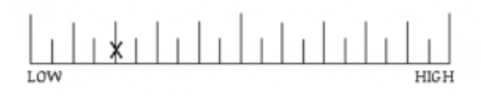
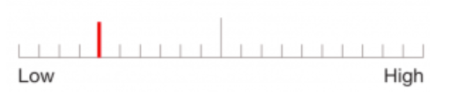
NASA TLX Rating the dimensions 2
For example, the images show the rating on a paper questionnaire (top) and on a mobile app (bottom)
The fifth tick mark is selected, so the rating score is: (5 – 1) * 5 = 20
Notes:
例如，这些图像显示了纸质问卷（顶部）和移动应用程序（底部）上的评分
选择了第五个勾号，因此评分为：（5–1）*5=20

Slide 16
NASA TLX What do the scores tell us?
If the weights are used then the individual ratings on each of the dimensions are multiplied by their respective weights, summed and divided by 15, resulting in an aggregate perceived workload score for a task ranging from 0 – 100.
If the weights are not used then the individual ratings on each of the dimensions can be summed and divided by 6, resulting in an aggregate perceived workload score ranging from 0 – 100.
The individual ratings on the 6 dimensions also give some insight in to where the workload is coming from. This can be helpful for developers hoping to improve their design.
Notes:
如果使用权重，则将每个维度上的个人评分乘以其各自的权重，相加并除以15，得出任务的总体感知工作量得分范围为0-100。
如果不使用权重，则可以将每个维度上的个人评分相加并除以6，从而得出0-100之间的总体感知工作量得分。
6个维度上的个人评级也让我们对工作量的来源有了一些了解。这对于希望改进设计的开发人员来说是有帮助的。

Slide 17
NASA TLX Validity
Hart and Staveland validated that the sub-scales measure different sources of workload.
Subsequent independent studies have also found that the NASA TLX is a valid measure of subjective workload (Rubio et al, 2004; Xiao et al, 2005).
Notes:
Hart和Staveland验证了子量表测量不同的工作量来源。
随后的独立研究也发现，NASA TLX是主观工作量的有效衡量标准（Rubio等人，2004年；Xiao等人，2005年）。

Slide 18
System Usability Survey (SUS)
The System Usability Scale (SUS) provides a “quick and dirty”, reliable tool for measuring usability.
It was created by John Brooke in 1986.
It consists of a 10 item questionnaire with five response options for each item ranging from Strongly agree to Strongly disagree.
It enables the evaluation of a wide variety of products and services, including hardware, software, mobile devices, websites and applications.
Notes:
系统可用性量表（SUS）为测量可用性提供了一个“快速而肮脏”的可靠工具。
它由约翰·布鲁克于1986年创建。
它包括一份10项调查问卷，每项有五个回答选项，从“强烈同意”到“强烈不同意”不等。
它能够评估各种各样的产品和服务，包括硬件、软件、移动设备、网站和应用程序。

Slide 19
System Usability Survey (SUS) - benefits
SUS has become an industry standard, with references in over 1300 articles and publications.
The noted benefits of using SUS include:
It is a very easy scale to administer to participants
It can be used on small sample sizes with reliable results
The SUS has been validated and shown to effectively differentiate between usable and unusable systems
Notes:
SUS已成为行业标准，在1300多篇文章和出版物中有参考文献。
使用SUS的显著好处包括：
这是一个非常容易对参与者进行管理的量表
它可以用于小样本量，结果可靠
SUS已经过验证，并被证明可以有效区分可用系统和不可用系统

Slide 20
System Usability Survey (SUS) - scale
When an SUS is used, participants are asked to score the 10 items with one of five responses that range from Strongly Agree to Strongly disagree i.e. using a five point Likert scale
Notes:
当使用SUS时，参与者被要求用从“强烈同意”到“强烈不同意”的五个回答中的一个对10个项目进行评分，即使用5分的Likert量表

Slide 21
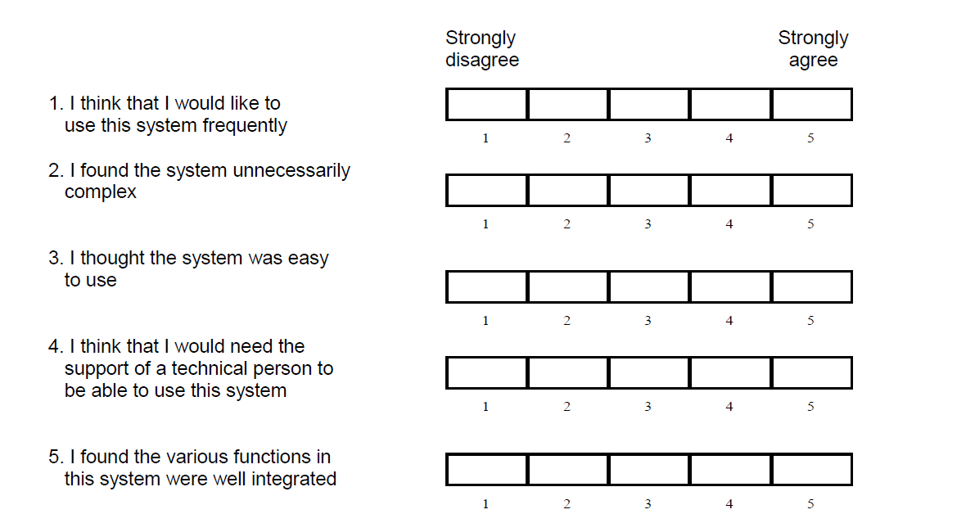
System Usability Survey (SUS) – scale 2

Slide 22
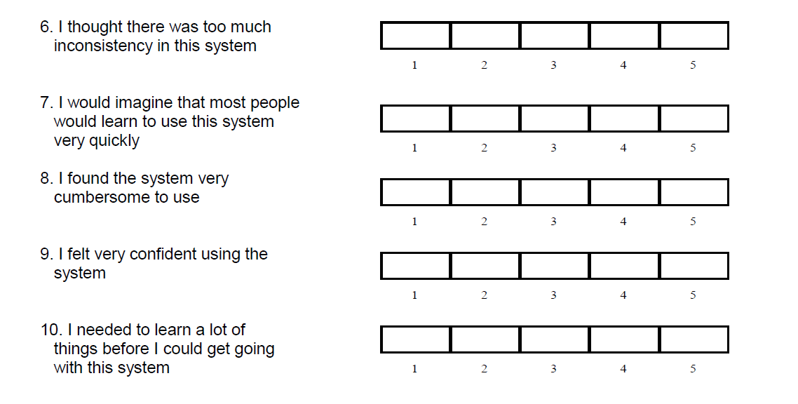
System Usability Survey (SUS) – scale 3

Slide 23
System Usability Survey (SUS) – scoring 1
The SUS is given to users when they have completed using the system which is being evaluated
They score each of the 10 items by marking one of the five boxes
The SUS yields a single number representing a composite measure of the overall usability of the system being studied. Note that scores for individual items are not meaningful on their own.
Notes:
SUS是在用户完成使用正在评估的系统时提供给他们的
他们通过标记五个框中的一个来对10个项目中的每一个进行评分
SUS产生一个单一的数字，表示所研究系统的整体可用性的综合衡量标准。请注意，单个项目的分数本身没有意义。

Slide 24
System Usability Survey (SUS) – scoring 2
To calculate the SUS score, first sum the score contributions from each item. Each item's score contribution will range from 0 to 4.
For items 1,3,5,7,and 9 (the odd numbered items) the score contribution is the scale position minus 1. For items 2,4,6,8 and 10 (the even numbered items) the contribution is 5 minus the scale position.
Multiply the sum of the scores by 2.5 to obtain the overall score.
SUS scores have a range of 0 to 100.
Based on research, a SUS score above 68 would be considered above average and anything below 68 is below average.
Notes:
要计算SUS分数，首先将每个项目的分数贡献相加。每个项目的得分贡献范围从0到4。
对于项目1、3、5、7和9（奇数项目），得分贡献为量表位置减去1。对于项目2、4、6、8和10（偶数项目），贡献为5减去刻度位置。
将分数之和乘以2.5，得到总分。
SUS分数在0到100之间。
根据研究，SUS分数高于68分将被视为高于平均水平，低于68分则低于平均水平。

Slide 25
Statistical testing
You might get a user to rate the SUS of two different designs and want to know if one design is significantly better than the other.
Similarly, you might want to know if two levels of difficulty in your game are significantly different so you get a user to rate the workload of both levels.
To determine whether the differences in scores are significantly different we can use a statistical test
Notes:
您可能会让用户对两种不同设计的SUS进行评分，并想知道其中一种设计是否明显优于另一种设计。
同样，你可能想知道游戏中的两个难度级别是否有显著差异，因此你可以让用户对两个级别的工作量进行评分。
为了确定分数的差异是否显著不同，我们可以使用统计测试

Slide 26
Statistical testing 2
There are many statistical tests but I am going to show you two that will be useful for your project.
The first is the Wilcoxon Signed Rank Test and it is ideal for analysing data from Likert and other scales e.g. the NASA TLX and SUS.
It is used when one user carries out two evaluations e.g. rates the workload of your game at two different difficulty levels.
It is a good test when you have small numbers of users – the minimum is 5; however, it’s better at identifying significant differences when you have larger numbers of users.
Notes:
有很多统计测试，但我将向您展示两个对您的项目有用的测试。
第一种是Wilcoxon符号秩检验，它是分析Likert和其他量表（如NASA TLX和SUS）数据的理想方法。
当一个用户进行两次评估时使用它，例如在两个不同的难度级别对游戏的工作量进行评级。
当用户数量较少时，这是一个很好的测试——最少为5个；然而，当用户数量较大时，它更善于识别显著差异。

Slide 27
Statistical testing 3
Make a table where each row represents a user’s scores and each column a separate evaluation score.
I’ve shown the results of three users evaluating the workload of a game at two difficulty levels using the NASA TLX.
You need a minimum of 5 and ideally more
User ID | Workload level 1 | Workload level 2
U1 | 25 | 67
U2 | 32 | 56
U3 | 18 | 43
Notes:
制作一个表格，每行代表一个用户的分数，每列代表一个单独的评估分数。
我展示了三个用户使用NASA TLX在两个难度级别上评估游戏工作量的结果。
你至少需要5个，最好更多

Slide 28
Statistical testing 4
Enter the data into the online calculator: https://www.statology.org/wilcoxon-signed-rank-test-calculator/
Look up the calculated W test statistic in the table of critical values
To do this you need to know N, which is the number of users, and the significance level, which we will set at 0.05
This means that if a significant difference is found then it is 95% certain that this is a real difference rather than due to randomness
Notes:
将数据输入在线计算器：https://www.statology.org/wilcoxon-signed-rank-test-calculator/
在临界值表中查找计算的W试验统计数据
要做到这一点，你需要知道N，即用户数量，以及显著性水平，我们将其设置为0.05
这意味着，如果发现显著差异，那么95%的人确信这是一个真正的差异，而不是由于随机性

Slide 29
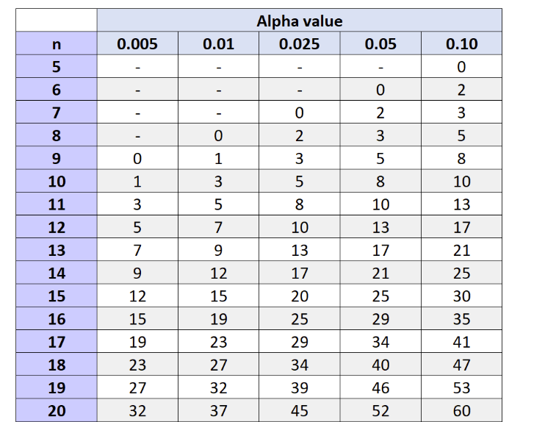
Statistical testing 5
We use an alpha value aka significance level of 0.05
We find the row that corresponds to our number of users aka n.
If we have 10 users then the W test statistic generated by the online calculator needs to be less than 8 otherwise there is no significant difference.
Notes:
我们使用一个α值，也就是0.05的显著性水平
我们找到与我们的用户数量（也称为n）相对应的行。
如果我们有10个用户，那么在线计算器生成的W检验统计量需要小于8，否则没有显著差异。

Slide 30
Statistical testing 6
If we are comparing two sets of values generated by two different groups e.g. experienced gamers and novice gamers then we use a different test to see if they are significantly different
This is known as the Mann-Whitney U test. There is also an online calculator and you can read about the test here:
https://www.statology.org/mann-whitney-u-test/
Notes:
如果我们比较两个不同群体（如经验丰富的游戏玩家和新手游戏玩家）产生的两组值，那么我们使用不同的测试来查看它们是否有显著差异
这被称为Mann-Whitney U检验。还有一个在线计算器，您可以在这里阅读有关测试的信息：
https://www.statology.org/mann-whitney-u-test/

Slide 31

Reading
Read the original paper on the NASA TLX:
Hart, S. G., & Staveland, L. E. (1988). Development of NASA-TLX (Task Load Index): Results of empirical and theoretical research. In Advances in psychology (Vol. 52, pp. 139-183). North-Holland.
Read the original SUS paper
Read more about the Wilcoxon signed rank test
Notes:
阅读关于NASA TLX的原始论文：
Hart，S.G.和Staveland，L.E.（1988）。NASA-TLX（任务负荷指数）的发展：实证和理论研究的结果。《心理学进展》（第52卷，第139-183页）。北荷兰。
阅读SUS原件
阅读更多关于Wilcoxon签名等级测试的信息

Slide 32


Before the workshop next week
Please review the lecture materials on the NASA TLX and SUS
Your workshop activities will involve evaluating your games using these two techniques
Notes:
请复习关于NASA TLX和SUS的讲座材料
您的研讨会活动将包括使用以下两种技术评估您的游戏

